Slide 1



ORDER MANAGEMENT SYSTEM
WITH GDG
PRESENTED BY
VIGNESH P

Slide 2

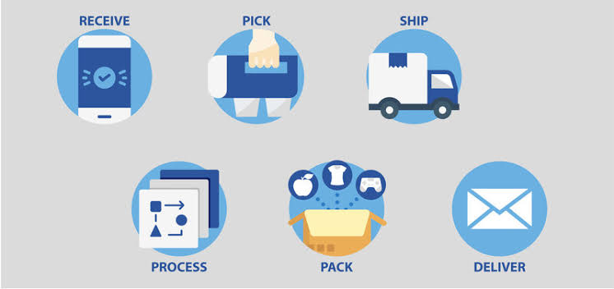
What is Order Management System?

Slide 3
Explanation:
Master and Transaction file as input
Master Layout: Transaction Layout:
Product id Transaction id
Product name Product id
Quantity on hand Quantity required
Price
Pending file and Shipping file as output.

Slide 4
1. The group of datasets related to each other by a common name 2. Many backup jobs,data collection jobs,update jobs are done on a daily basis in production envirnoment. 3. A Maximum of 255 generations are allowed for a GDG base
Generation Data Groups(GDG):

Slide 5
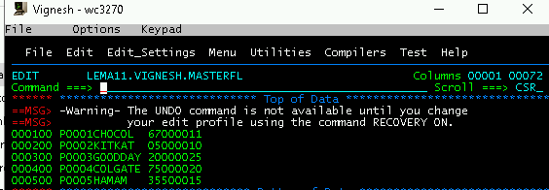
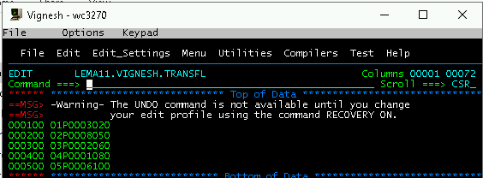
Master File:
Transaction File:

Slide 6
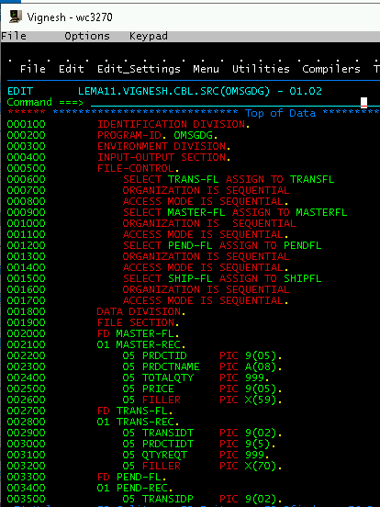
Source Code:

Slide 7
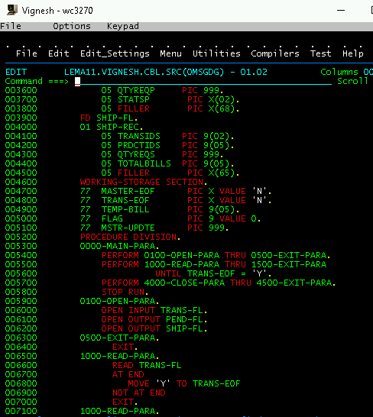

Slide 8
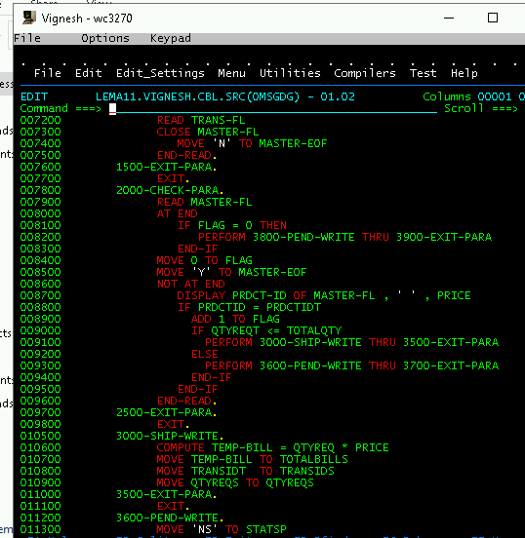

Slide 9
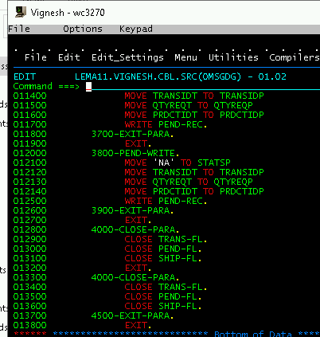

Slide 10
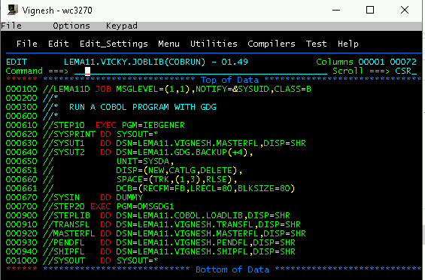
Jcl with Gdg:

Slide 11
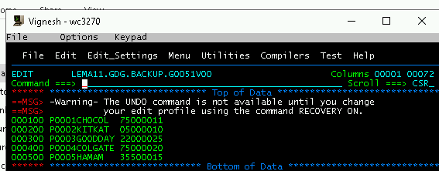
Backup File :
Updated Master File :

Slide 12
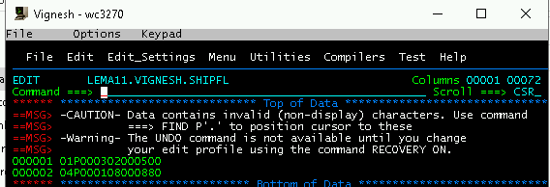
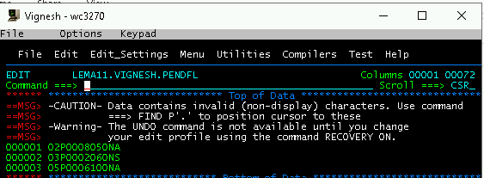
Shipping File:
Pending File:

Slide 13


Thank you
Reimagine technology to
accelerate your business
www.htcinc.com
www.caretech.com
www.ciber.com

